Slide 1
Applied Data Science Capstone Project
The Battle of Neighborhoods

Slide 2
The Battle of Neighborhoods – Charlotte, NC
The city of Charlotte, North Carolina has seen tremendous economic and population growth over the past 20 years
According to U.S. Census data, from 2005 to 2015, Charlotte topped the U.S. in millennial population growth
It is currently the third-fastest-growing major city in the United States, per the Seattle Times
A group of investors is considering adding a quick-service empanada franchise to the Charlotte region and needs help determining which of Charlotte's 199 bustling neighborhoods is the best fit
The ideal location would provide a consistent mix of traffic to the restaurant from the lunch hour business crowd, working parents on the go in the early evening, as well as weekend traffic from the arts and entertainment crowd

Slide 3
Data Acquisition
The Foursquare API will be used to determine the ideal neighborhood in which to launch the empanada restaurant
The neighborhoods will be clustered and subsequently evaluated based on their proximity to corporate office buildings, family style attractions, gyms, other Latin American-style restaurants as well as non-Latin American-style restaurants
Because the data available in Foursquare does not include neighborhood specific details, it will be analyzed based on venue categories by postal code first, followed by finding the 10 most common venues per postal code to determine the best location

Slide 4
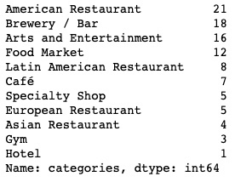
Foursquare – Data Cleaning
Cleaning the data required narrowing the 58 venue categories down to 11
Gaps in the Foursquare data emerged, namely lack of Hotel and Gym information along with few neighborhood listings

Slide 5
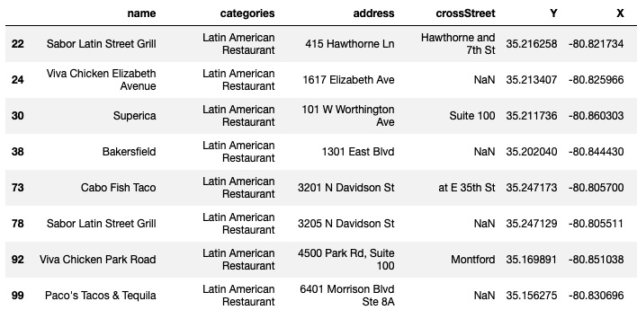
Filtering for the Competition
Currently, there are only 8 Latin American-themed restaurants in Charlotte

Slide 6
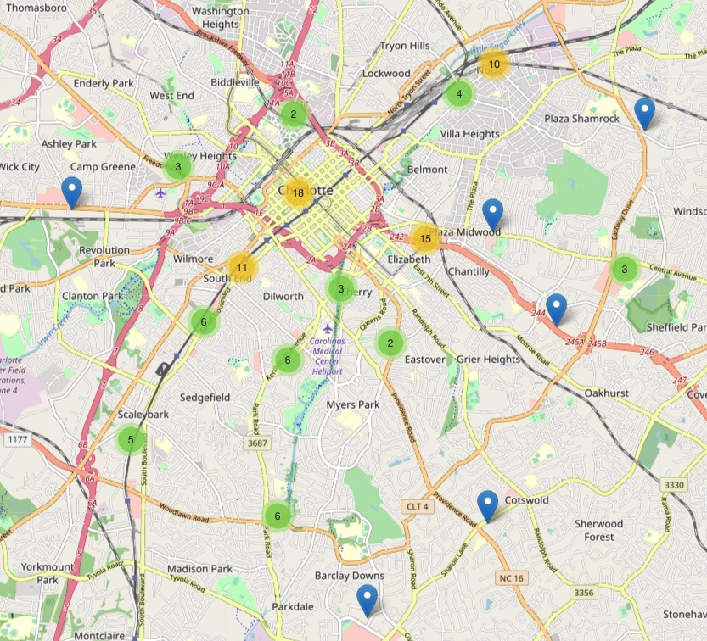
Charlotte’s Venues
Clustering the venues enabled patterns to emerge
The heaviest concentrated areas (in yellow) are in Uptown, Elizabeth, South End and NODA

Slide 7
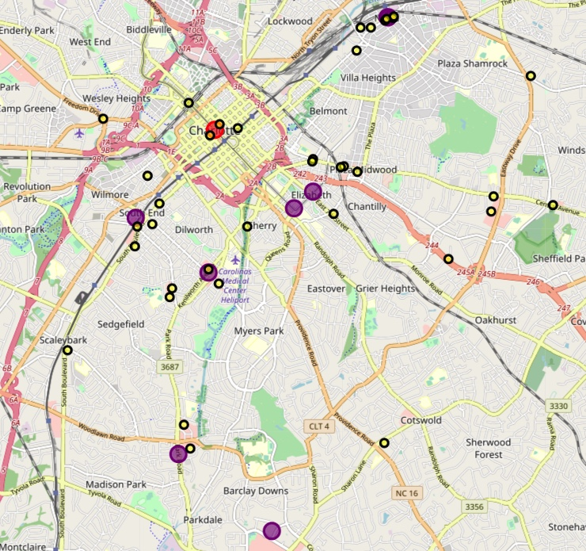
Latin America versus the Rest
The 8 Latin American restaurants (in purple) are outside of the center of Charlotte
Another gap exposed: there are definitely more than 4 restaurants (in yellow) in Uptown Charlotte
The Foursquare API is considered to be the source of truth for this analysis

Slide 8
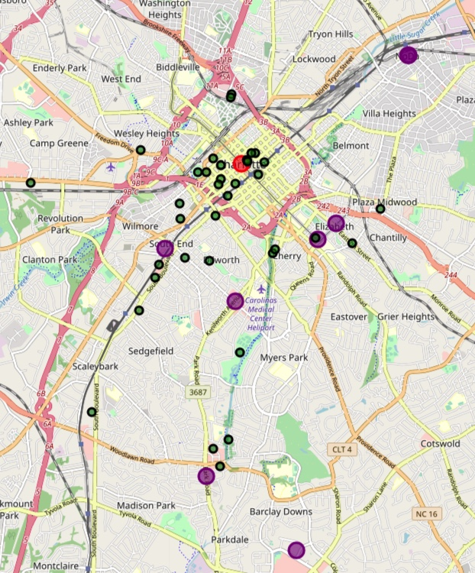
Arts, Entertainment…Shopping
Uptown Charlotte contains the heaviest concentration of the cultural, arts, entertainment, gym and shopping venues (in green) ... And yet no Latin American Restaurants (in purple)

Slide 9
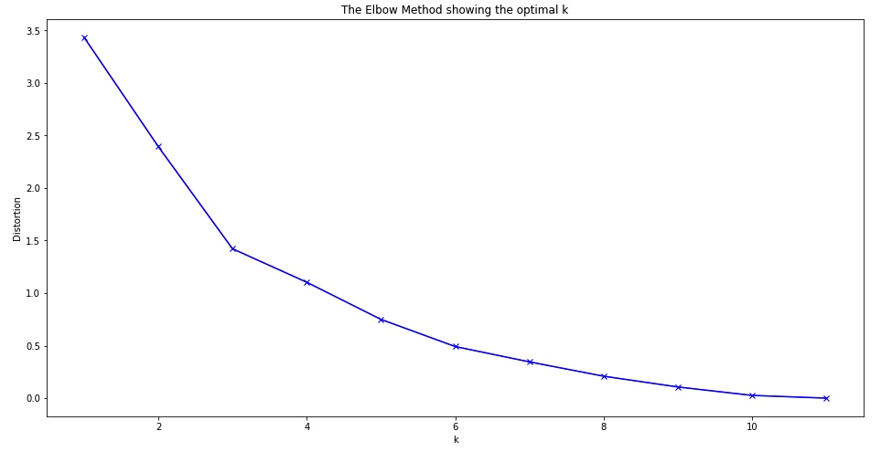
K-means clustering
If the k is too low, the model will be too complex
If the k is too high, it will be an overly generalized model
Neither of which would be ideal for predictive purposes
*The graph appears to indicate that 3 could be the optimal k, however several iterations of this clustering analysis produced an outcome that made more sense when using 6 clusters

Slide 10
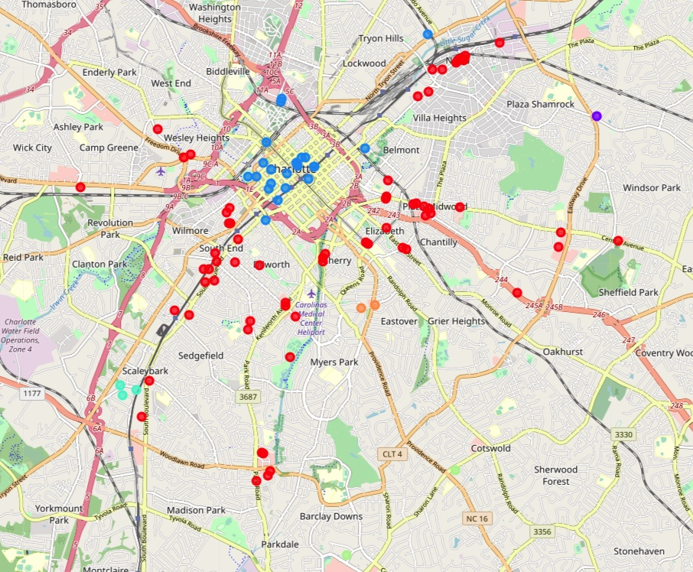
K-means Clustering
The clusters appear to spiral out from the center of Charlotte, with blue in the center (cluster 2), then a heavy concentration of red (cluster 0), with light blue (cluster 3), orange (cluster 5), purple (cluster 1) and light green (cluster 4) sprinkled here and there

Slide 11
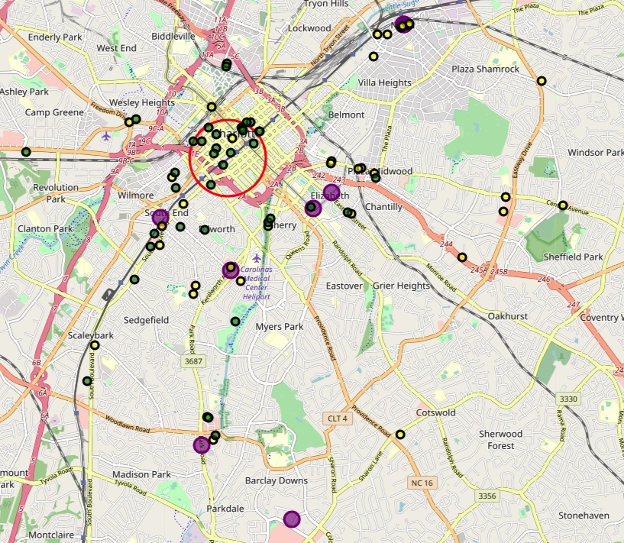
And the winner is….
This map highlights the lack of penetration that Latin American-themed restaurants have in an area heavily dominated by a thriving arts and entertainment section of Charlotte
Uptown also hosts the corporate headquarters of several fortune 500 companies, most notably Bank of America and Wells Fargo
Any restaurant in this area could expect a steady stream of customers on nights and weekends, but also during the lunch hour, making this a perfect location for the proposed empanada quick service restaurant

